Slide 1
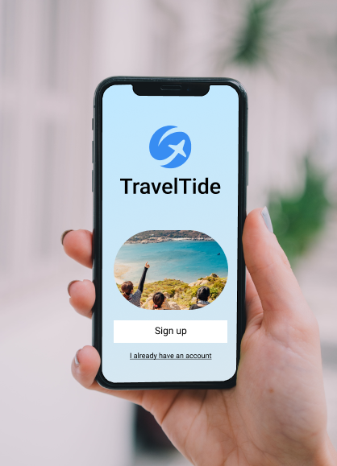
Traveltide Customer Segmentation & Reward Program
By Saira Aslam

Slide 2
Unlocking Customer Loyalty:
TravelTide's Path Forward
Objective:
Creating Unique Experiences for Our Customers with Customized Rewards
Approach:
Using Smart Data to Personalize Your Travel Rewards Experience

Slide 3
Objectives
Identify distant customer segmentation
Align segments with travel tailored perks
Enhance customer retention

Slide 4
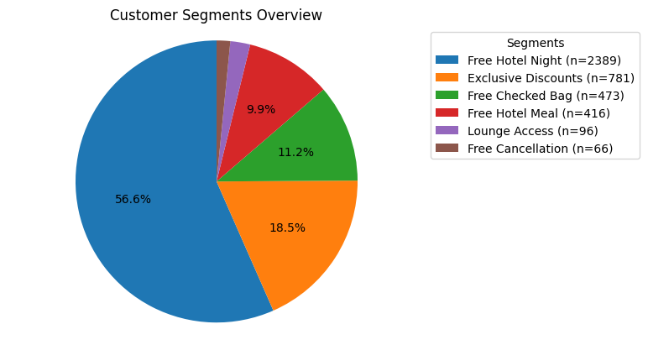
Key Findings: Who are our customer
▪High Value Travelers
Exclusive Discounts
▪The Planner’s Choice
Free Hotel Meal
▪Long Stay Guests
Free Night Hotel Stay with Flight
▪The Global Traveler
Complimentary Lounge Access
▪Families and Groups
Free Checked Bag
▪The Flexible Traveler
Free Cancellation

Slide 5
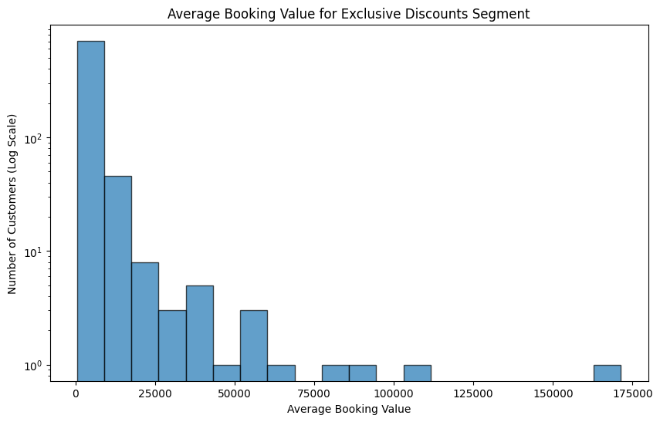
High Value Traveler
▪Criteria
Top 15% of customers by spend
during the cohort period
▪Average Customer Lifetime Value
$11,511
▪Size of Segment
781
▪Recommended Perk
Exclusive Discounts

Slide 6
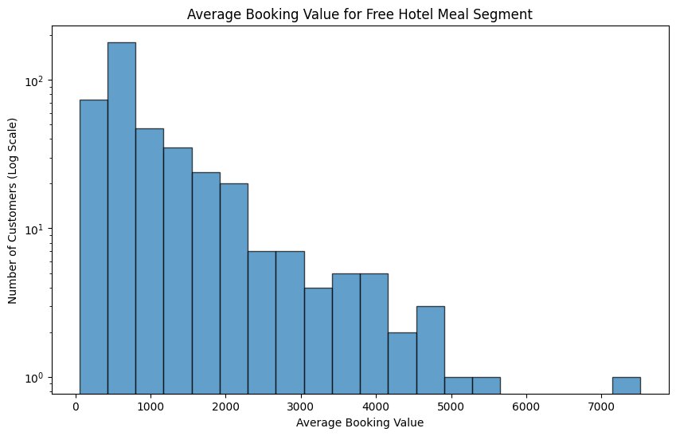
The Planner’s Choice
▪Criteria
Early Bookings and 1-Night Stays
▪Average Customer Lifetime Value
$2,495
▪Size of Segment
416
▪Recommended Perk
Free Hotel Meal

Slide 7
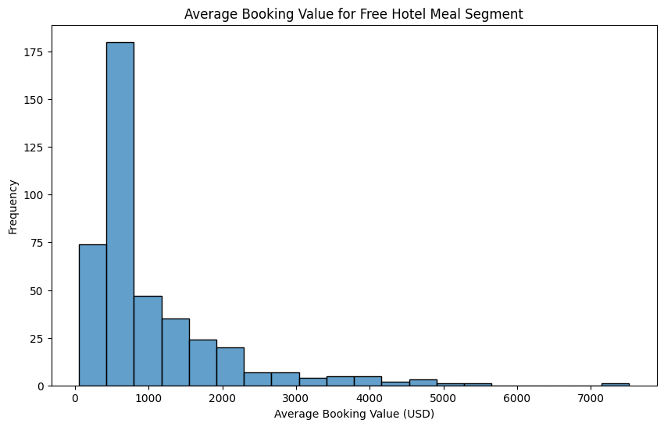
The Long-Stay Guest
▪Criteria
Trips of 4 nights or more
▪Average Customer Lifetime Value
$1,886
▪Size of Segment
2,389
▪Recommended Perk
Free Night Hotel Stay with Flight

Slide 8
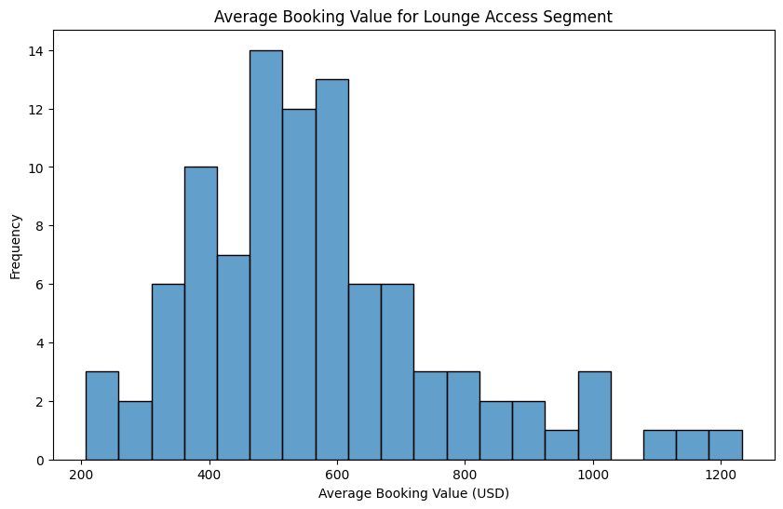
The Global Traveler
▪Criteria
International Travelers
▪Average Customer Lifetime Value
$2,261
▪Size of Segment
96
▪Recommended Perk
Complimentary Lounge Access

Slide 9
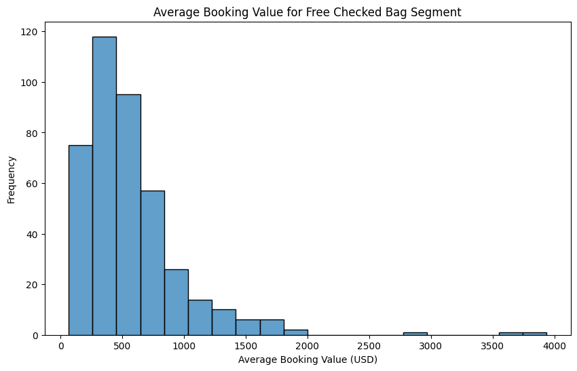
Families and Groups
▪Criteria
Families: Married with Children
Groups: 6 or more airplane seats OR
3 or more hotel rooms booked
▪Average Customer Lifetime Value
$1,085
▪Size of Segment
473
▪Recommended Perk
Free Checked Bag

Slide 10
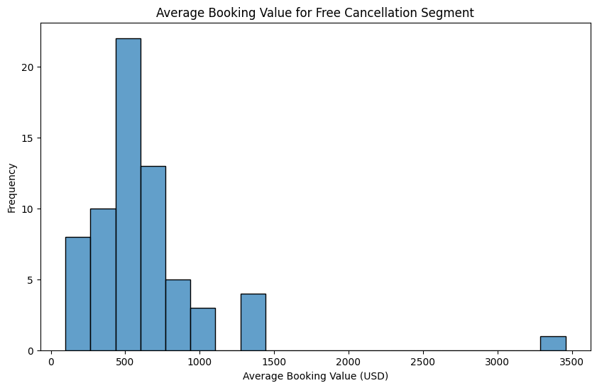
The Flexible Traveler
▪Criteria
Have a session with the sole intention
of cancelling a booking
▪Average Customer Lifetime Value
$1,783
▪Size of Segment
66
▪Recommended Perk
Free Cancellation

Slide 11
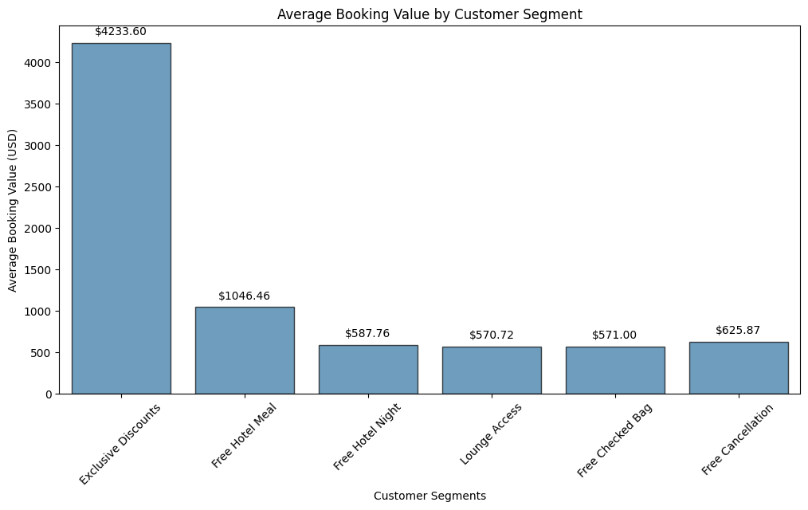
Key Findings: Who are our customer

Slide 12
Recommendations:
A/B Testing for Segment Validation
Objective: Validate the effectiveness of targeted perks for each customer segment.
Metrics: Conversion Rates, Customer Engagement
Timeline: 3 - 6 Months
Feedback Mechanism: Establish a system for gathering direct customer feedback to continuously refine the rewards program

Slide 13
Recommendations:
Launch the Rewards Program
Targeted Email Campaign
Customized Perks for Each Segment
Personalized Messaging
Refine Segments
Focus on High-Value Customers
Tiered Rewards System
Key Performance Indicators
Customer Lifetime Value (CLV)
Engagement Rates

Slide 14
Thank You

